Slide 1
Sri Vinya Godavarthi
Analysis of edX MOOC data
using Python

Slide 2
Overview of MOOC and edX
MOOC (massive open online course) is an online course aimed at unlimited participation and open access via the web.
Provides video lectures, problem sets, interactive user forums to support interactions between students, professors, and TAs.
First introduced in 2008 and emerged as a popular mode of learning in 2012.
edX (www.edx.org) is a MOOC provider built by Harvard and MIT.
It hosts online university-level courses in a wide range of disciplines to a worldwide audience, some at no charge.
It is nonprofit and runs on an open-source software platform.
Launched in May2012, provides courses in English, Spanish, French, Hindi and currently has more than 3 million users and over 300 courses as of Oct 2014.
Source: http://en.wikipedia.org/

Slide 3
About the DataSet
Source: Harvard Dataverse Network
File Name: HMXPC13_DI_v2_5-14-14.csv
Contents: Data set of students who took courses on edX between 2012 - 2013.
Records: 641,138 rows
Consists of De-identified data from the first year (Academic Year 2013: Fall 2012, Spring 2012 and Summer 2013) of MIT and Harvard courses on the EdX Platform.
Data is at the level of one row per person, per course.

Slide 4
Initial set of Questions on observing the dataset
How popular is this learning tool? How much is it’s reach?
Do users actually complete a course once they have started?
What group of people are more likely to use this facility?
Can we categorize this information by age, level of education, country?
What are the most popular courses?

Slide 5
Question 1
Top 10 Popular Courses based on:
number of students registered in MOOC
countries where they are popular
number of Male and Female Participants

Slide 6
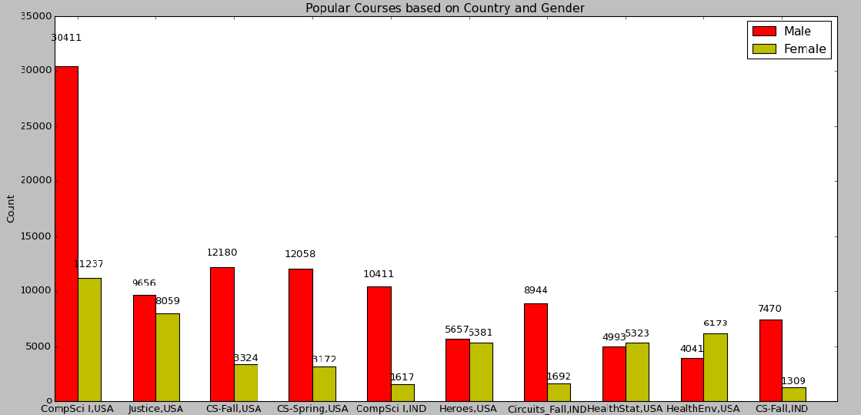
Graphical Representation of Output for Question 1

Slide 7
Question 2
What is the Level of Education of participants who were registered in MOOC?
Considering only those users who at least explored the course material

Slide 8
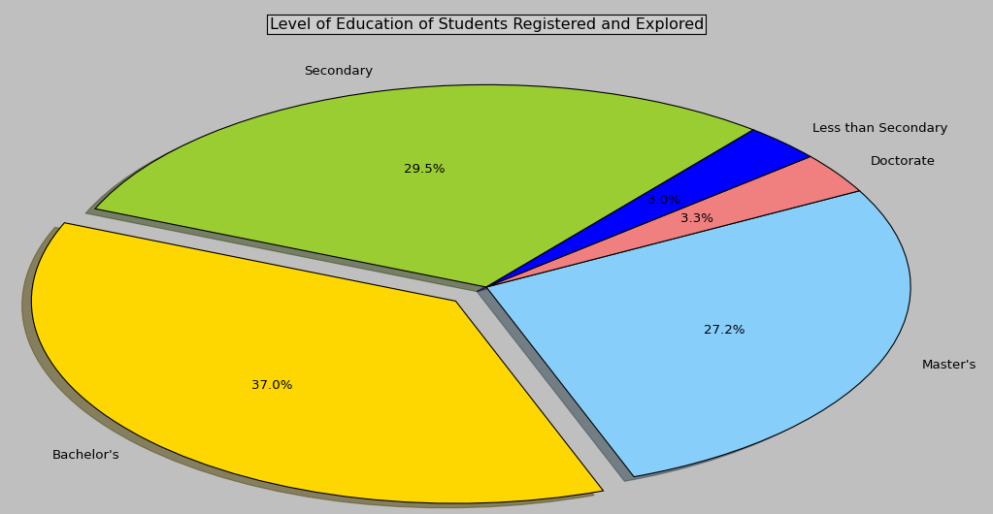
Graphical Representation of Output for Question 2

Slide 9
Question 3
What is the age group of students across all courses who are interested in MOOC?

Slide 10
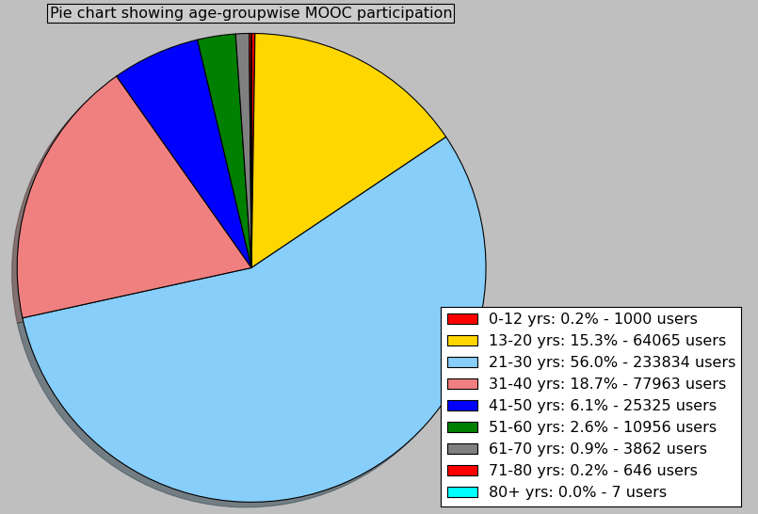
Graphical Representation of Output for Question 3

Slide 11
Question 4
How many students took more than one course over different time periods?
i.e. find out number of students who came back to the site to take another course.

Slide 12
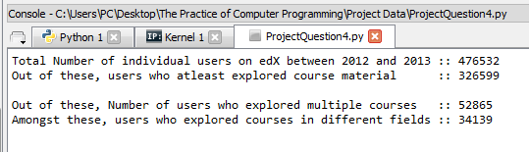
Output for Question 4

Slide 13
Question 5
What is the popularity / reach of MOOCs world wide?
Calculate number of users per country.
Find each country’s internet reach and literacy rate.
Use these as factors in ranking the countries.

Slide 14
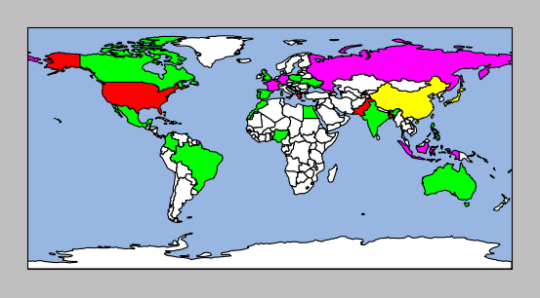
Graphical Representation of Output for Question 5

Slide 15
Question 6
Ratio of students joining to the ratio of students completing each course.
From this, we can also know courses having highest certification rate and courses having highest number of participants.

Slide 16
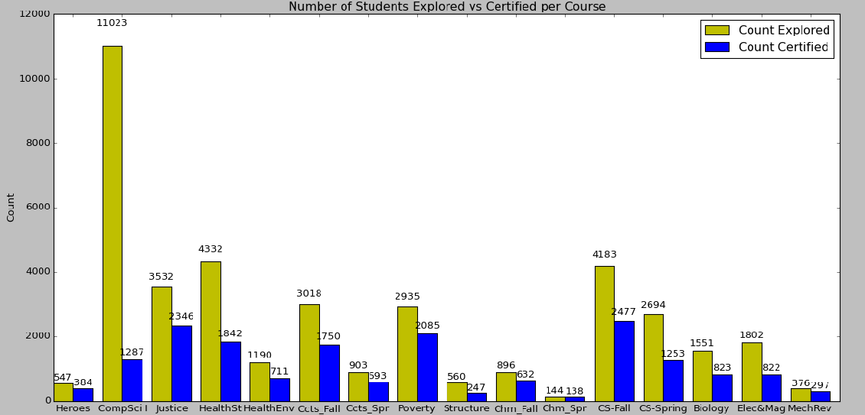
Graphical Representation of Output for Question 6

Slide 17
Challenges faced
Dataset took long time to execute initially.
Modified the data structures used.
Filtered out unnecessary data at initial stages itself
Many road blocks faced during import of packages for cartopy.
Used Anaconda
Installed packages GEOS, PROJ4.0, Shapely, pyshp
Finally installed cartopy
Modified a config file (siteconfig.py) within cartopy to resolve URL access issue.
Used defaultdict package to ease use of dictionary with sets, lists as values.

Slide 18
References / Useful Links
Dataset source : https://dataverse.harvard.edu/dataset.xhtml?persistentId=doi:10.7910/DVN/26147
To install cartopy: http://scitools.org.uk/cartopy/docs/latest/installing.html
Installing cartopy with whl file: http://stackoverflow.com/questions/21958457/installing-cartopy-using-souce-file
Using defaultdict: https://www.accelebrate.com/blog/using-defaultdict-python/
Count: http://stackoverflow.com/questions/11290092/python-elegantly-merge-dictionaries-with-sum-of-values

Slide 19
Thank You !!

